Slide 1
Childhood Trauma, Psychosis and Neurofeedback
Dr Vivek Sharma
9 December 2020

Slide 2
Trauma
“ Trauma is a dehumanizing experience in which those subjected to it are reduced to the status of objects, victim of someone else’s rage, nature’s indifference, misfortune or misadventure. It involves being plunged into a state of helplessness…when physical control is lost.”
“Childhood Trauma is the experience of a highly distressing event or situation during youth that is beyond one’s capacity for coping and/or control.”

Slide 3
Childhood Trauma and Psychosis
Section 1

Slide 4
Research into relationships between early adversity and psychological problems later in life.
Role of childhood trauma (CT) especially sexual and physical abuse and increasingly emotional abuse and neglect.
Although childhood adversities- such as parental loss, separation, discord, bullying contribute to later psychopathology-CT appears to have particularly long-lasting effects.

Slide 5
CT has been associated with most psychiatric disorders including mood and anxiety disorders, eating disorders, personality disorders, dissociative disorders, and SUD.
More recently the role of CT in later development of psychosis has come to forefront.
Uncertainty about whether or not psychotic patients’ report can be trusted or not- is unfounded.

Slide 6
Mayo et al 2017 reviewed literature on incidence of CT in CHR population
CHR/UHR (“ultra high risk)” syndrome is diagnosed by semi-structured interviews-
Structured Interview for Psychosis Risk Syndromes (SIPS)
Comprehensive Assessment of At-Risk Mental States (CAARMS)
CHR diagnosis is based on
subthreshold psychotic-like sx (e.g. pos, neg, disorganized)
general psychopathology (e.g., depression, anxiety)
functioning
family history

Slide 7
Summary
Higher rates of trauma among CHR (86.8%) compared to healthy controls (HC).
CHR individuals at greater risk for physical trauma (83%) than the general population (17%).
Physical trauma associated with poorer cognitive functioning.
CHR youth endorsed a lifetime history of physical and psychological bullying (30 and 60%) that was much higher than HC (14 and 36%)
Bullying victimization an important form of childhood adversity, effects continue in adulthood.

Slide 8
Sexual abuse history-> mood and anxiety disorders, substance abuse, posttraumatic stress disorder (PTSD), eating disorders, suicidal behaviours, and psychosis.
Sexual abuse history -> higher rates of positive symptoms of a sexual nature
feelings of being watched while bathing, hearing voices say sexual statements
CHR females (but not males) -> higher stress-sensitivity scores mediating association between trauma and attenuated positive psychotic symptoms
females cope with trauma differently, internalize experiences

Slide 9
Strong relationship between CT and severity of psychosis symptoms in the CHR population.
Role of significant life experiences (SLE) in triggering transition to psychosis has not been clearly substantiated.
Sexual abuse was associated with later psychosis conversion, followed by physical abuse.
Trauma appears to predict conversion to psychosis, but may not function independently of other known risk factors such as more severe positive symptoms, cognition, and functioning.

Slide 10
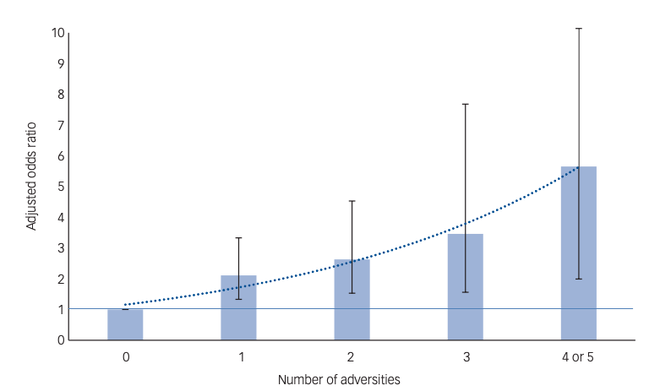
Morgan et. al. (2020) in a case (n=374) control (n=301) study [“Childhood Adversity and Psychosis (CAPsy)”]
2- to 4-fold increased odds of psychosis with adversity
Dose-dependent increase of odds with exposure to multiple adversities

Slide 11
Five types of adversities: House hold discord, Psychological abuse, Physical abuse, Sexual abuse, Bullying
Odds were greatest for those who reported-
early (under 11 years)
frequent (at least weekly)
severe exposure (extreme threat, hostility, violence)
Some adversities (e. g. bullying, sexual abuse) more strongly associated with psychosis if first occurrence in adolescence
consider brain plasticity- when young people are acutely sensitive to peer influence and comparisons

Slide 12
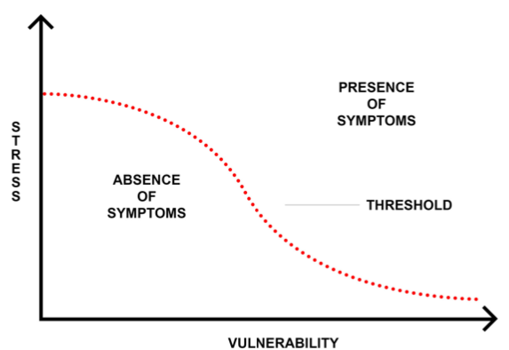
Mechanism of Trauma in CHR individuals
Cognitive, affective and/or biological
Stress-vulnerability Model
Zubin and Spring
Individuals possess a genetic or biological vulnerability to psychosis and can withstand a certain amount of stress.
Beyond a threshold the risk of psychosis increases.

Slide 13
Stress-Sensitization Model
Individuals experience their first psychiatric illness when they have a biological vulnerability and experience a major stressor.
After this vulnerability increases requiring less stress for the person to develop recurrent or more severe psychiatric issues
Partial evidence reported in the NAPLS study, in which CHR individuals who converted to psychosis not only reported more SLEs but also experienced higher levels of self-reported stress than those who remitted.

Slide 14
Trauma and the HPA Axis
Abnormalities in cortisol secretion in CHR samples compared to HC.
Participants who converted to full psychosis in the had higher mean daily cortisol levels than those who remitted.
May be related to the high rates of mood and anxiety disorders rather than being central to psychosis.
Dysregulated stress response with altered cortisol secretion may be evidence of a subgroup of CHR individuals who experience an affective/stress pathway to psychosis.

Slide 15
Amygdala
Both amygdala and dopamine system are involved in the regulation of emotion responses, including fear, and the attachment of salience to external stimuli.
Dissociation
Trauma increased likelihood of dissociation, which has been implicated in the development of hallucinations

Slide 16
Cognitive Mechanisms
Early adversity may lead to the formation of negative schemas of the self, others, and the surrounding environment.
Such negative views may contribute to greater external locus of control and increased symptoms of suspicious or paranoia.
CT may be associated with faulty responses to environmental stimuli, such as informational processing bias for negative or irrelevant stimuli.

Slide 17
Cognitive Mechanisms
Early adversity may lead to the formation of negative schemas of the self, others, and the surrounding environment.
Such negative views may contribute to greater external locus of control and increased symptoms of suspicious or paranoia.
CT may be associated with faulty responses to environmental stimuli, such as informational processing bias for negative or irrelevant stimuli.

Slide 18
QEEG and Psychosis
Section 2

Slide 19
Advantages of QEEG
EEG power spectrum highly predictable and is regulated by a complex neuroanatomical and neurochemical homeostatic system.
Genetically based and normative data have been established and repeatedly replicated.
Economical, non-invasive, rapid to administer, easy to exchange and reprocess.
Successful treatment results in normalization of the previously demonstrated QEEG abnormalities.
E

Slide 20
Harris et. al. (1999)
N=40 medicated individuals with schizophrenia
Principal component analysis (PCA) of PANSS supported a “tripartite” model instead of “positive-negative dichotomy”
All 3 subtypes was associated with distinct QEEG characteristic.
There was no appreciable difference of medication or duration of illness.
E

Slide 21
John et. al. (2007)
Large numbers of individual across two sites USA and Germany
Diagnosed with schizophrenia, depression with psychosis, and alcoholic psychosis with DSM-IV in USA and ICD-10 in Germany.
Cluster analysis of QEEG from the USA group yielded 6 clusters which was replicated in the German sample.
E

Slide 22
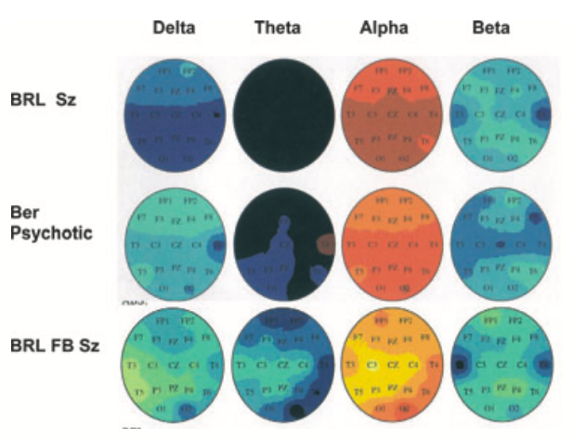
Patients diagnosed as schizophrenic using DSM-IV, Psychotic depression using ICD-10, and first-episode schizophrenia as were found within each cluster and showed no significant QEEG differences.
Similar underlying mechanism regardless of diagnosis.
E

Slide 23
Neurofeedback Research in Psychosis
Section 3

Slide 24
Bolea (2010) reported a case with treatment resistant schizophrenia, resident of psych hospital x 20 years
Pre-NF assessment: QEEG, Neuropsych testing (WAIS), individualized behaviour checklist.
NF delivered in 3 phases-
P1: right parietal training @ P4-A1 /PO4-A1 (alpha up and hibeta down) x 40 sessions
P2: brief left frontal training @ FC3-A1 (low beta up and delta down) -> Right parietal as above
P3: right parietal @ PO4-CP4 (alpha up and hibeta down) x 10 min -> Left frontal @ FC3-FP1 (delta down and lobeta up) x 10 min -> Right parietal @ PO4-CP4 (alpha up and hibeta down) x 20 min

Slide 25
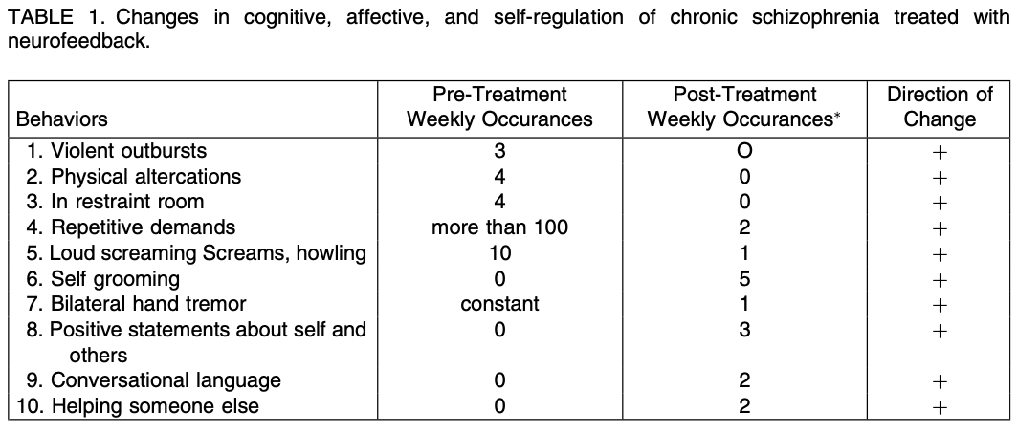

Slide 26
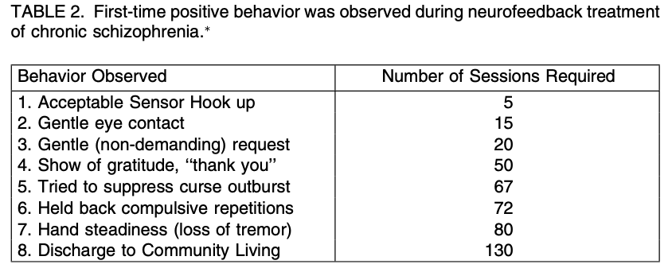
Positive changes in behavioral self-regulation, cognitive, and affect regulation.
Resumed community living w
2 yr follow-up documented satisfactory adjustment with stabilization on <1/2 number and dosage of medication.
Similar outcomes in 70 other chronic inpatients.

Slide 27
Surmeli et al. (2012)
N= 51, duration 9 yr, PANSS score > 70 (avg. 110)
At least 1 ineffective treatment with avg. number of medications 3.4 (+ 2.1)
Pre NF: PANSS, MMPI, TOVA, QEEG, NxLink database
Post-medication washout QEEG findings:
73% increased alpha
20% increased theta
Hypercoherence in 63%
Asymmetry in 43%

Slide 28
Sensor placement based on QEEG z-scores and presenting symptoms
Hypercoherence
Back of head (Pz/O1)
Brodman Area 10- WM, Executive functions, Emotional regulation, Motivation
Brodman Area 46- WM, sustained Attention, response inhibition, verbal memory retrieval
Fpo2- Anxiety, Fear
Sensorimotor area- Calming
Paranoia
Auditory Hallucination
Visual Hallucinations

Slide 29
48 out of 51 completed the rx
Mean number of sessions- 58
Mean PANSS scores reduction- 82%
47 showed “response” based on criterion (>20% reduction on PANSS)
Overall compliance high-68 %
Trend towards “Normalization” of all MMPI scores
19 no longer classified as schizophrenia on NxLink database
27 remained medication free and an additional 14 required monotherapy

Slide 30
Pazooki et. al. (2018)
N= 2, ICD-10 Schizophrenia, Residual Type
Pre NF measures: PANSS, GAF, CompACT-SR
NF delivered in 2 phases
P1: SMR up and Theta down @ contralateral central site (C3/ C4)
P2: P1+ Beta 1 (13-18) up and Theta (4-8Hz) down @ F3
Total 20 sessions
Significant improvement in Reaction times and GAF
Neither met criteria for Negatives syndrome on PANSS

Slide 31
Benefits of NF
Effects of medication is not consistent. Newer antipsychotics may help in reliving negative symptoms but perhaps not in mood and cognitive symptoms.
Improved self-regulation of neural activity with cognitive/affective effects, including improving working memory, intelligence, and emotional prosody.
Meta-analysis have shown efficacy in ADHD and Epilepsy it has been suggested that modulation of neural networks is “stable” yielding longer lasting results.
Evidence is emerging for other conditions such as OCD and autism.
i

Slide 32
References
Thompson AD, Nelson B, Yuen HP, Lin A, Amminger GP, McGorry PD, et al. Sexual trauma increases the risk of developing psychosis in an ultra high-risk “prodromal” population. Schizophr Bull (2014) 40(3):697–706.
Yung AR, Cotter J, Wood SJ, McGorry P, Thompson AD, Nelson B, et al. Childhood maltreatment and transition to psychotic disorder independently predict long-term functioning in young people at ultra-high risk for psychosis. Psychol Med (2015) 45(16):3453–65.
Arseneault L, Cannon M,Fisher HL,Polanczy kG,Moffitt TE,Caspi A.Childhood trauma and children’s emerging psychotic symptoms: A genetically sensitive longitudinal cohort study. Am J Psychiatry 2011; 168: 65–72.
Bolea AS. Neurofeedback treatment of chronic inpatient schizophrenia. Journal of Neurotherapy. 2010 Mar 3;14(1):47-54.
Surmeli T, Ertem A, Eralp E, Kos IH. Schizophrenia and the efficacy of qEEG-guided neurofeedback treatment: a clinical case series. Clinical EEG and Neuroscience. 2012 Apr;43(2):133-44.
Pazooki K, Leibetseder M, Renner W, Gougleris G, Kapsali E. Neurofeedback Treatment of Negative Symptoms in Schizophrenia: Two Case Reports. Applied psychophysiology and biofeedback. 2019 Mar 15;44(1):31-9.
Gandara V, Pineda JA, Shu IW, Singh F. A Systematic Review of The Potential Use of Neurofeedback in Patients with Schizophrenia. Schizophrenia Bulletin Open. 2020 Mar 2.

Slide 33
References
Mayo D, Corey S, Kelly LH, Yohannes S, Youngquist AL, Stuart BK, Niendam TA, Loewy RL. The role of trauma and stressful life events among individuals at clinical high risk for psychosis: a review. Frontiers in psychiatry. 2017 Apr 20;8:55.
Morgan C, Gayer-Anderson C, Beards S, Hubbard K, Mondelli V, Di Forti M, Murray RM, Pariante C, Dazzan P, Craig TJ, Reininghaus U. Threat, hostility and violence in childhood and later psychotic disorder: population-based case–control study. The British Journal of Psychiatry. 2020 Oct;217(4):575-82
Harris AW, Williams L, Gordon E, Bahramali H, Slewa-Younan S. Different psychopathological models and quantified EEG in schizophrenia. Psychological Medicine. 1999 Sep;29(5):1175-81
John ER, Prichep LS, Alper KR, Mas FG, Cancro R, Easton P, Sverdlov L. Quantitative electrophysiological characteristics and subtyping of schizophrenia. Biological Psychiatry. 1994 Dec 15;36(12):801-26.
John ER, Prichep LS, Winterer G, Herrmann WM, DiMichele F, Halper J, Bolwig TG, Cancro R. Electrophysiological subtypes of psychotic states. Acta Psychiatrica Scandinavica. 2007 Jul;116(1):17-35.
Surmeli T, Ertem A. Obsessive compulsive disorder and the effi- cacy of qEEG-guided neurofeedback treatment: a case series. Clin EEG Neurosci. 2011;42:195–201.

Slide 34
Thank You

